Slide 1
Theme 7: Easter- Our Reason to Hope
The Easter Season began on Easter Sunday and continues for fifty days until the feast of Pentecost on May 23 this year.
The liturgical colour for the season of Easter is white as a symbol of the hope offered in the resurrection.
Christian hope means believing that God is with us at all times and that what ever our situation that we may trust on the gift of God’s grace to get us through.
Christian hope is based on the belief that, even though our bodies will eventually die, we will rise again to a new and eternal life with God in heaven.

Slide 2
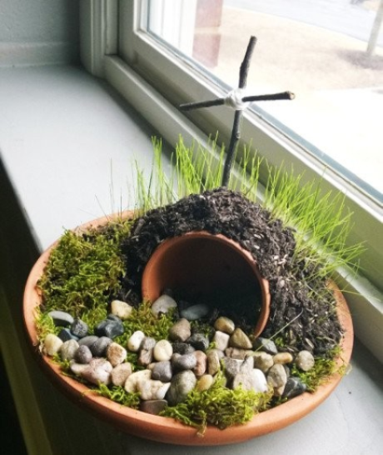
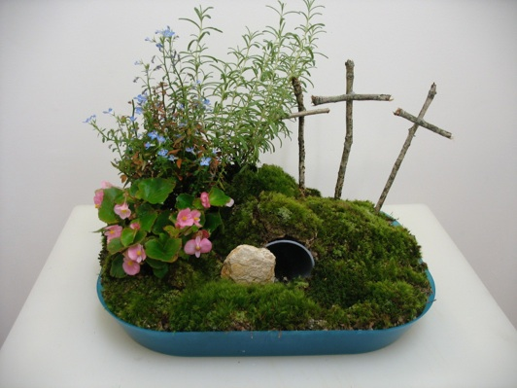
Let’s Look…..
Prayer
Prepare the Easter sacred space.
Place a white cloth/page as a background.
Add the cross/crucifix, candle and Bible.
You might wish to make a small Easter garden as a sign of hope.

Slide 3
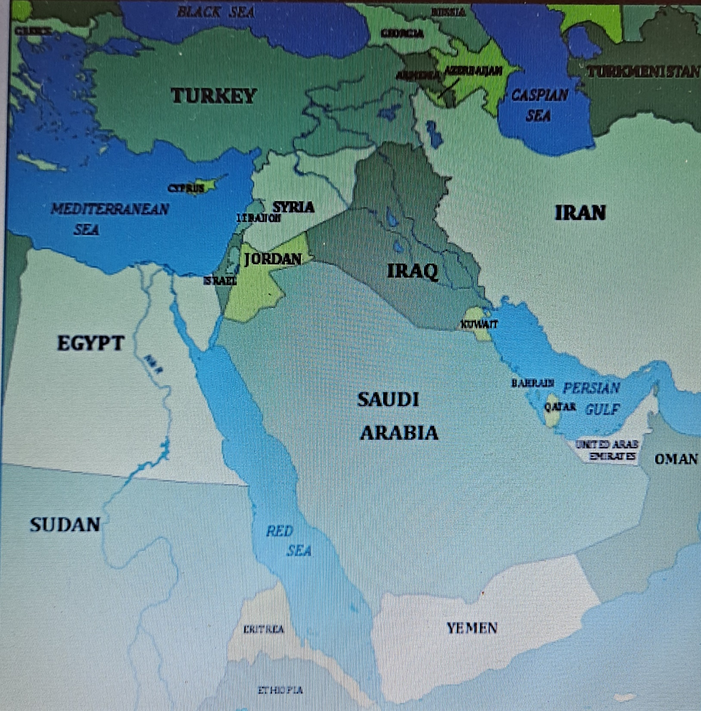
Click on audio button

Slide 4
Vimeo about Hope in difficult times
Go to www.growinlove.ie for a vimeo on the experiences of three young men from Afghanistan and Syria who speak of their experience of being refugees.
Username: trial@growinlive.ie
Password: growinlove
https://app.growinlove.ie/en/user/lesson-resources/510
Chatting
Why did the men leave their homes?
What difficulties did they encounter on their journey?
What kept them going?
What have you learnt from the vimeo?

Slide 5
Connecting the vimeo with the experience of Jesus, Mary and Joseph
Click on the audio button

Slide 6
A Moment of guided reflection and Prayer Service of Hope
Click on the audio button
Response: Lord, fill all people with your hope and love.
Act of Hope
O my God, I put my hope in you
because I am sure of your promises.
Deliver us, Lord, from every evil
and grant us peace in our day,
as we wait in joyful hope
For the coming of our Saviour, Jesus Christ,. Amen

Slide 7
Let’s Learn….
Look at presentation of Imagine You Were There online at
www.growinlove.ie
Username: trial@growinlive.ie
Password: growinlove
https://app.growinlove.ie/en/user/lesson-resources/510
Discuss the meaning of the words afterwards.

Slide 8
Visualisation
Click on the audio button

Slide 9
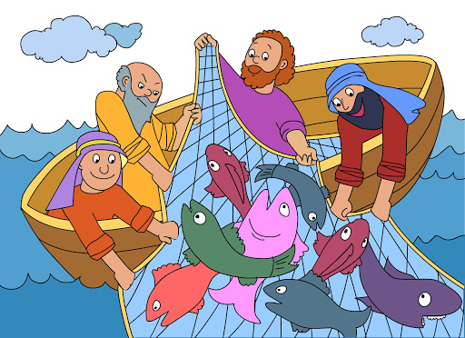
Sacred Scripture
You may wish to read the account of Jesus Appears to the Seven Disciples in your textbook on page 79, or in the Bible at John 21:1-14 or listen to it on the audio below.

Slide 10
Chatting
Consider the questions on page 80 of your text book.
Ask some questions with Curious Clare in link below
www.growinlove.ie
Username: trial@growinlive.ie
Password: growinlove
https://app.growinlove.ie/en/user/lesson-resources/510
Do you agree with Clare?
What questions do yoiu ask?

Slide 11
Let’s Live….
The Big Question!
Go online for the Big Question and when the music runs to completion click on each of the three pictures to listen to stories of hope from people who were struggling with great challenges.
www.growinlove.ie
Username: trial@growinlive.ie
Password: growinlove
https://app.growinlove.ie/en/user/lesson-resources/510

