Slide 1
Theme 8: Eucharist
Lesson 1: At Mass We Give Thanks
This lesson provides an opportunity to consider how the Mass is central to our human story and in the context of our salvation history.

Slide 2
Let’s Look….
Read page 82 in pupil text book.
Journaling exercise
What is the best gift that you ever got?
Why was it the best?
Why do we give gifts?
How do you choose a gift for someone?
What do you think is the best gift that God has given to you?

Slide 3
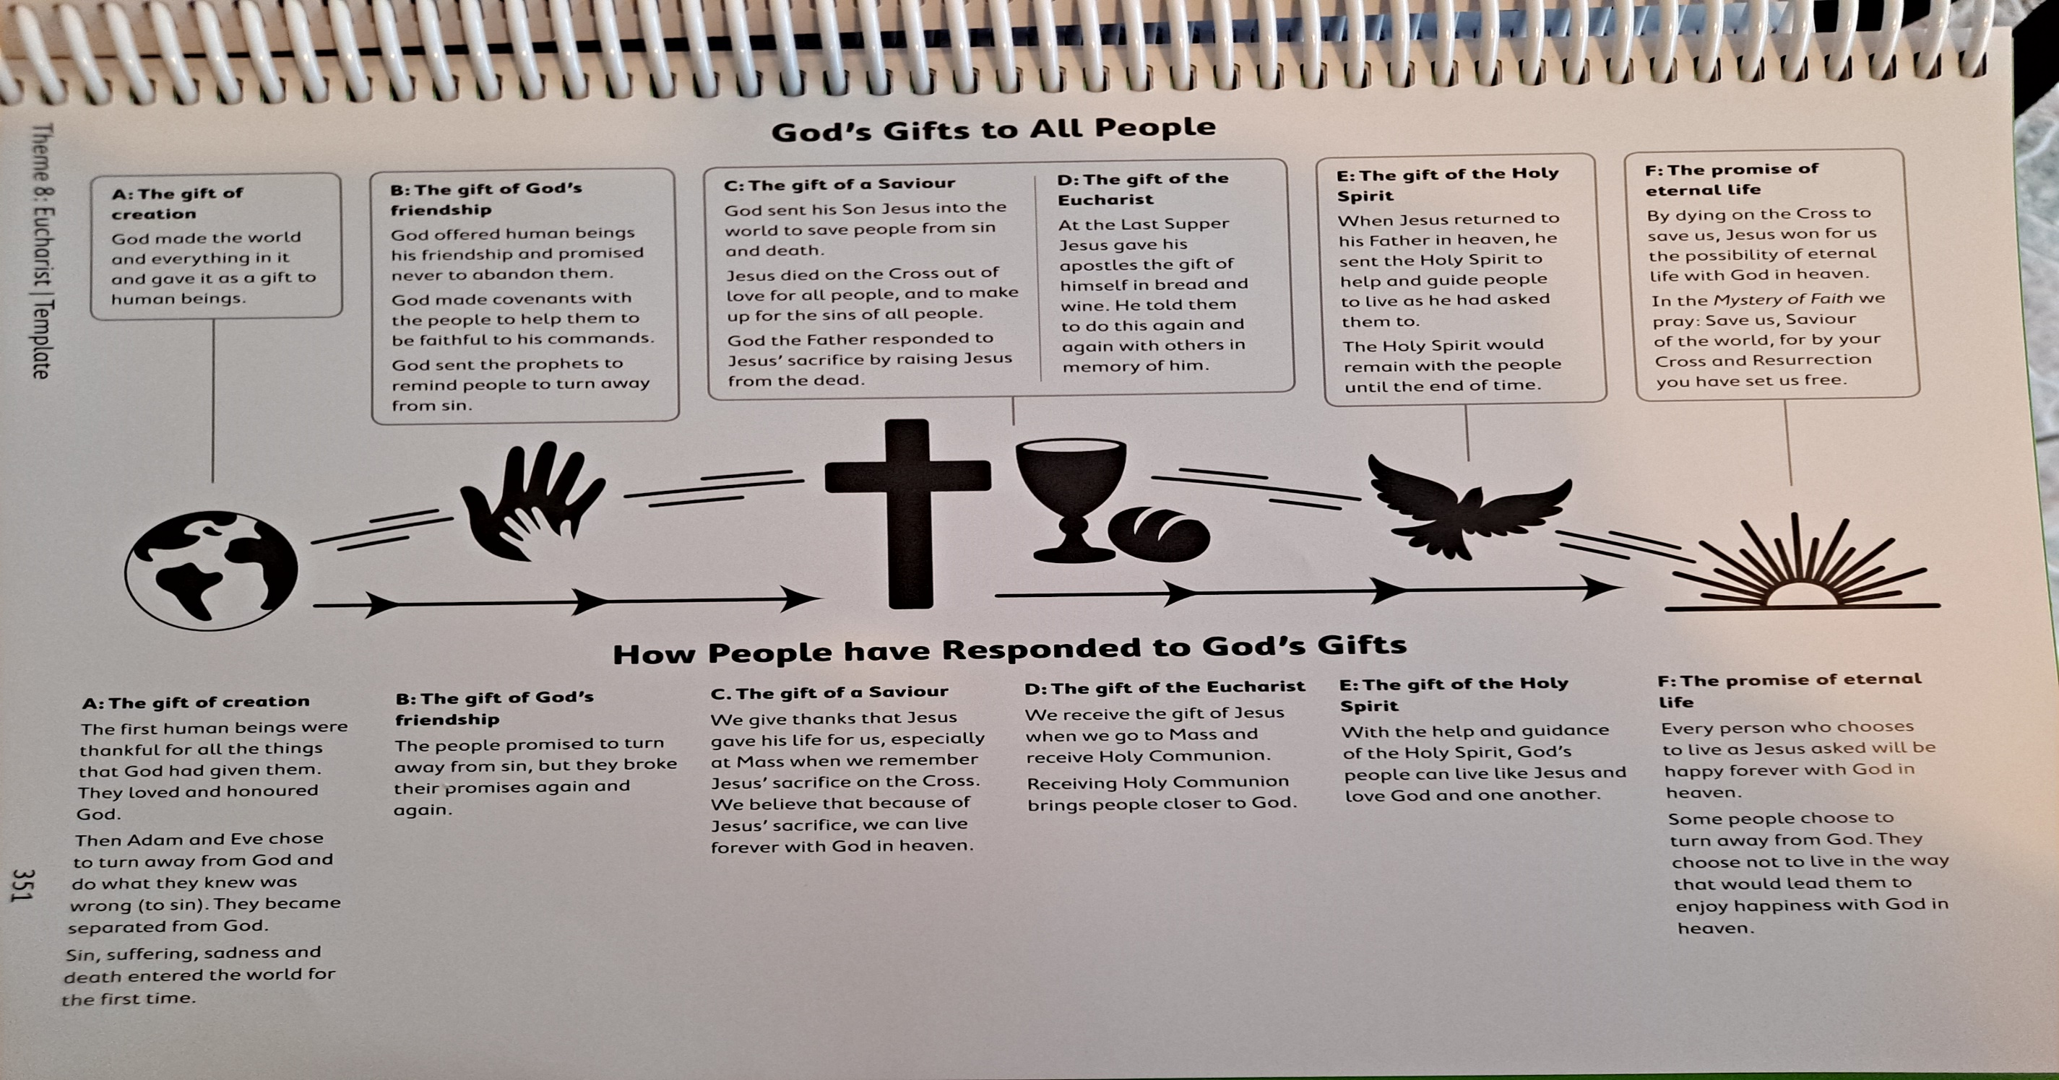
Let’s Learn….

Slide 4
Consider
Consider each of the gifts on the last side and the response made by people to each one.
How do they relate to you own life?
Meditation
Click on the audio button.

Slide 5
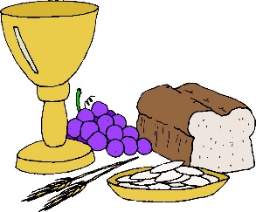
The Presentation of Gifts
Go to vimeo on the Offertery/Presentation of Gifts at
Username: trial@growinlive.ie
Password: growinlove
https://app.growinlove.ie/en/user/lesson-resources/511

Slide 6
The word Eucharist means Thanksgiving.
The greatest gift that God has give us is Jesus our Saviour.
God came among us as man so that he could show us the fullness of life and be our salvation through his own suffering.
At the Presentation of Gifts in the Mass/Eucharist, bread and wine are brought forward to the altar as offerings to be transformed into the Body and Blood of Jesus.
God works with ordinary things and people to make great things happen.
Water is added to the wine in the preparation of gifts representing us!
We are joined with Jesus in the sacrifice as we offer ourselves so that we can become what we truly should be if we let ourselves be guided by God.

Slide 7
Curious Clare
Go to Curious Clare at www.growinlove.ie
Username: trial@growinlive.ie
Password: growinlove
https://app.growinlove.ie/en/user/lesson-resources/511
Do you agree/disagree with any of the points?

Slide 8
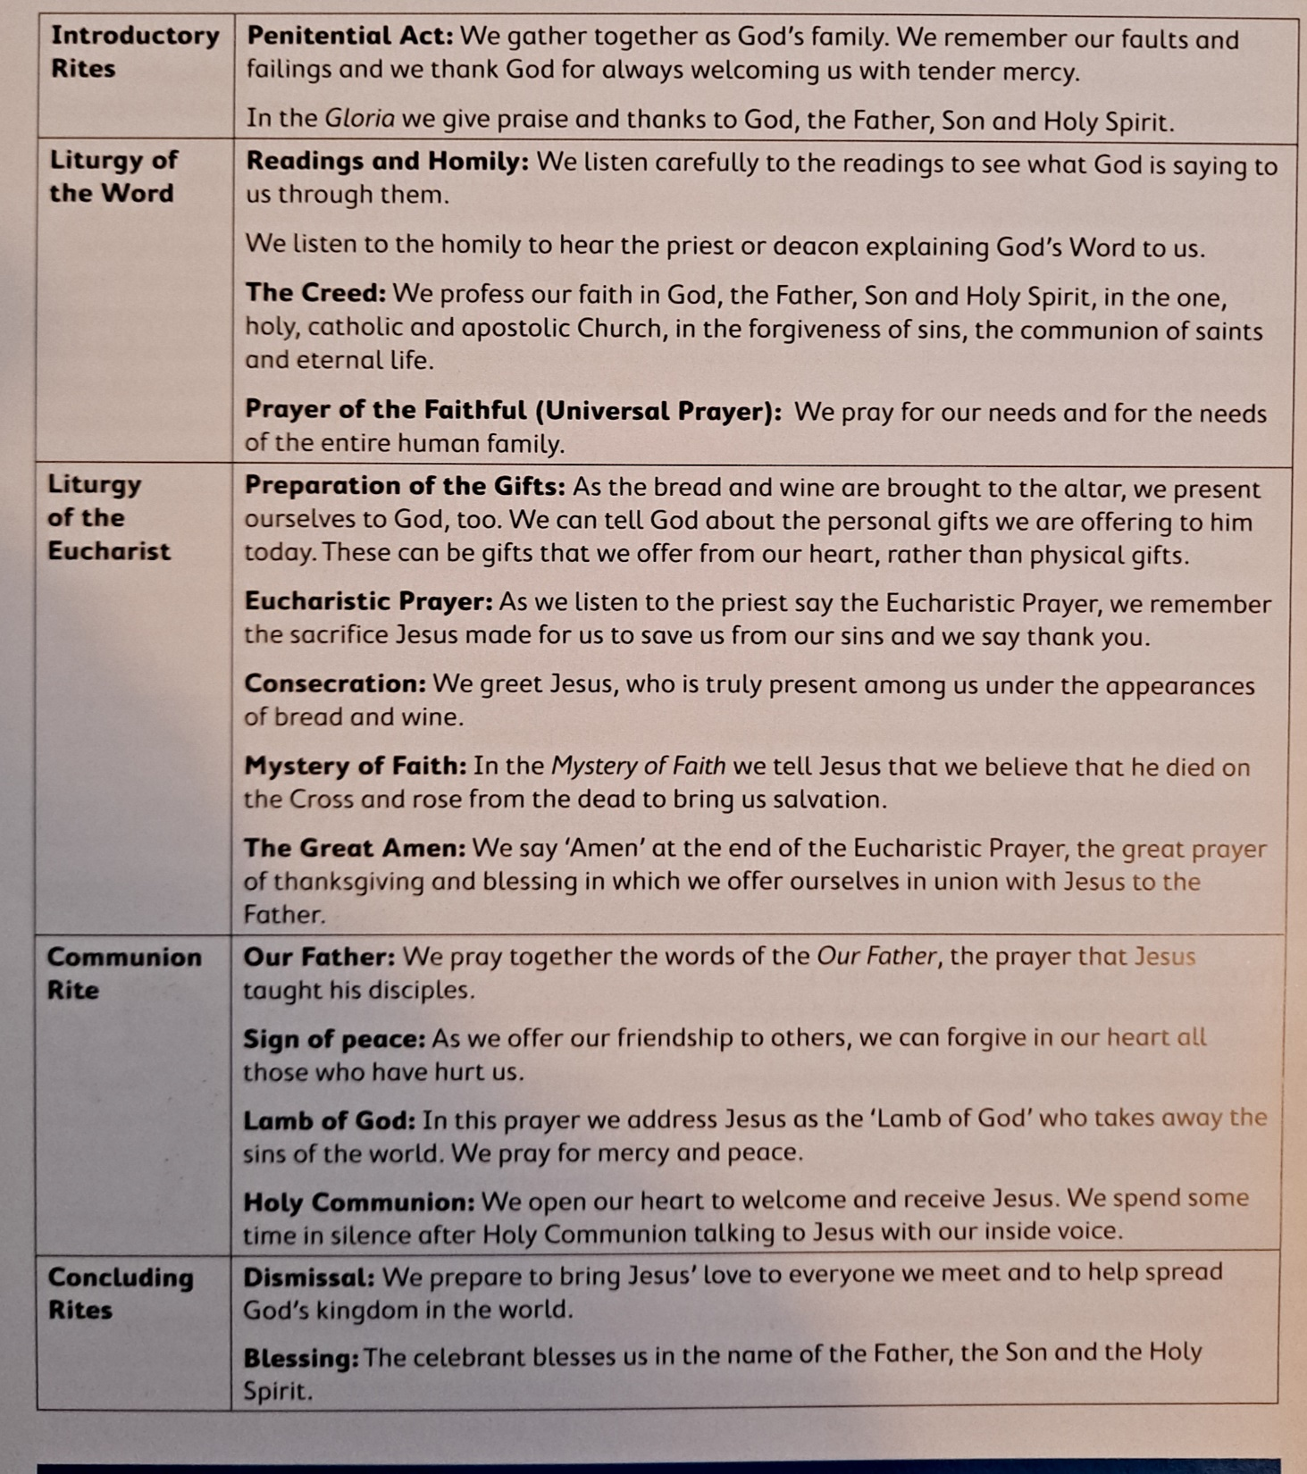
Consider the parts of the Mass and what each part means as explained on the left.
The Eucharist: Our Family Gathering with God
We come together as family.
We acknowledge what we have done wrong so that we can enjoy the celebration together without any barrier.
We hear our family stories in the scripture readings: they have a fresh message for each of us.
We remember those in need in our prayers.
We discuss our beliefs.
We bring gifts and provide ourselves as gifts by sharing time.
We are changed and we accept the gift of Jesus who offers himself anew to us.
We go from the gathering carrying what we have gained from being together with God so that we can build a better world that day and that week.

Slide 9
Let’s Live…
Draw or write about one way that you will use a gift that God has given you to bring joy or comfort to someone you know.

