Slide 1
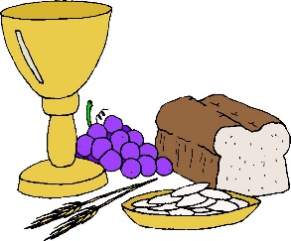
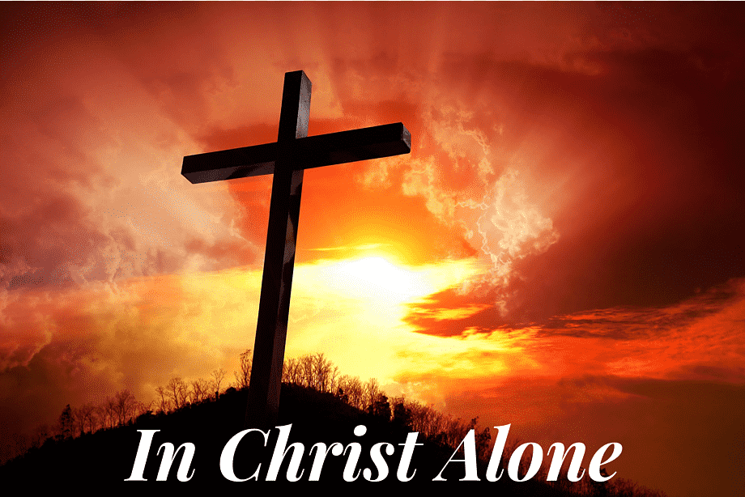
Theme 8: Lesson 2
At Mass We Remember Jesus’ Sacrifice

Slide 2
The Birthday Surprise
How was Elizabeth feeling at the beginning of the story?
How was she at the end of the story?
What do you think of Elizabeth’s parents?
How do you think Elizabeth felt?
Can you think of a time when someone made a sacrifice for you?
Click on the audio button.

Slide 3
Prayer Service
Sign of the Cross
Light a candle in the sacred space.
We will listen to some verses from the Book of Judith in the Old Testament.
Judith 16:13-16
If gathered as a class or family, please read aloud.
If it suits your situation better, use the audio buttons on each page.
Click on audio button

Slide 4
1. I will sing a new song to my God
O Lord, you are strong and glorious!
You have never been defeated.
2. Let all your creatures serve you,
You gave the command
And all of them came into being;
You breathed on them
And all of them were created.
No one can oppose your command.
Choose four readers to read a verse each
3. The mountains and the seas tremble,
And rocks melt like wax when you come near.
But there is mercy for all who obey you.
4. The Lord is more pleased with those who obey him
Than with all the choice meat at the altar,
Or with the most fragrant sacrifices.
Click on audio button

Slide 5
Conclusion
Today we pray in thanks to God for all the sacrifices others have made for us. Let’s take a few minutes in silence to pray for the people in our lives who love us so much that they make sacrifices for us.
We finish our prayer by praying the Our Father together.
Click on audio button

Slide 6
Let’s Learn…..
Jesus has many titles, as have each one of us.
Look at the interactive activity online on the titles of Jesus.
Username: trial@growinlive.ie
Password: growinlove
https://app.growinlove.ie/interactives/6th_titles_for_jesus_and_the_mass/index.php

Slide 7
A Christian Hero
St Maximilian Kolbe sacrificed his life to save another man. Read about him on page 87 in your pupil’s book and/or listen to the audio.
Read the questions on page 87 in your book and discuss.
What do you think about the sacrifice that Fr Maximilian made?
Click on audio button

Slide 8
Remembering Jesus’ Sacrifice at Mass
Read about We remember Jesus’ Sacrifice at Mass on page 87 in pupils book.
Use the interactive materials on Remembering Jesus online at
Username: trial@growinlive.ie
Password: growinlove
https://app.growinlove.ie/interactives/6th_remembering_jesus_sacrifice_at_mass/index.php

Slide 9
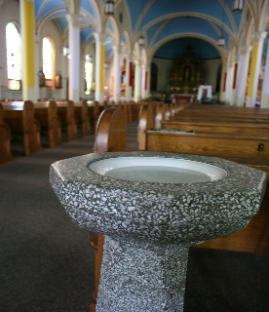
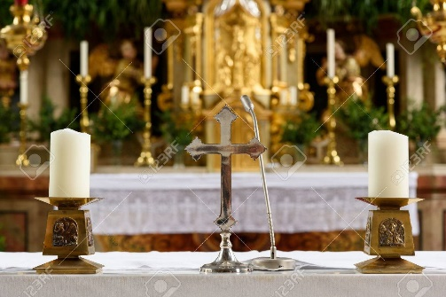
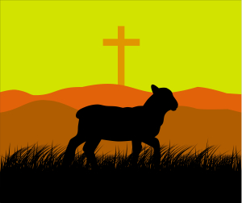
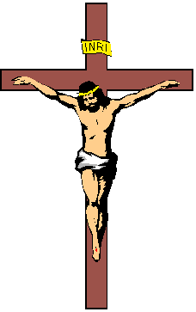
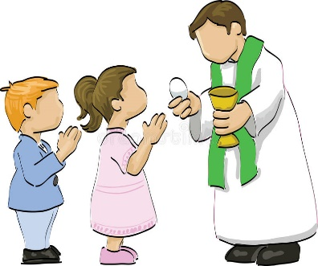
Reminding of the symbols and images presented in the interactive materials:
Jesus, Lamb of God
Holy Water Font
Candles on Altar
Crucifix
Bread and wine
Receiving Holy Communion

Slide 10
The Body of Christ (page 88 in pupil’s book and audio clip below)
The Parable of the Real Vine (John 15:1, 4-5)
Click on audio button
Click on audio button

Slide 11
Let’s Live…
Discussion and Journaling
DO you think that the image of the vine and branches is a good image for God and our connection with God through his people, the church?
Imagine that you are a cut off branch and what that existence would be like?
Who are the people, thoughts, images and prayers that help you to remain connected to the vine?
As a branch needs nourishment from the body of the vine, what support do you need to keep your faith alive today?

Slide 12
Meditation Prayer on the Vine
Click on audio button

