Slide 1
Grow in Love 4
Theme 9
Lesson 2: Growing in Love

Slide 2
Let’s Look…..
Prayer
Click on audio button

Slide 3
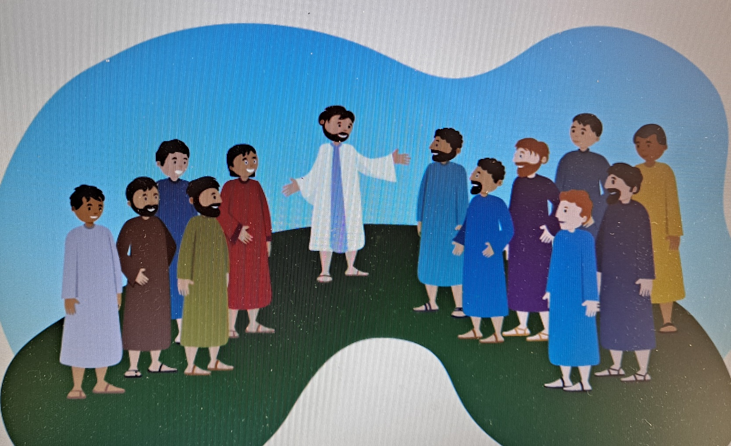
Let’s Learn…..
Let us look at pictures of some of the stories and themes about which we learned this year in this slide and the next few to follow.
Jesus called his disciples to follow him.

Slide 4
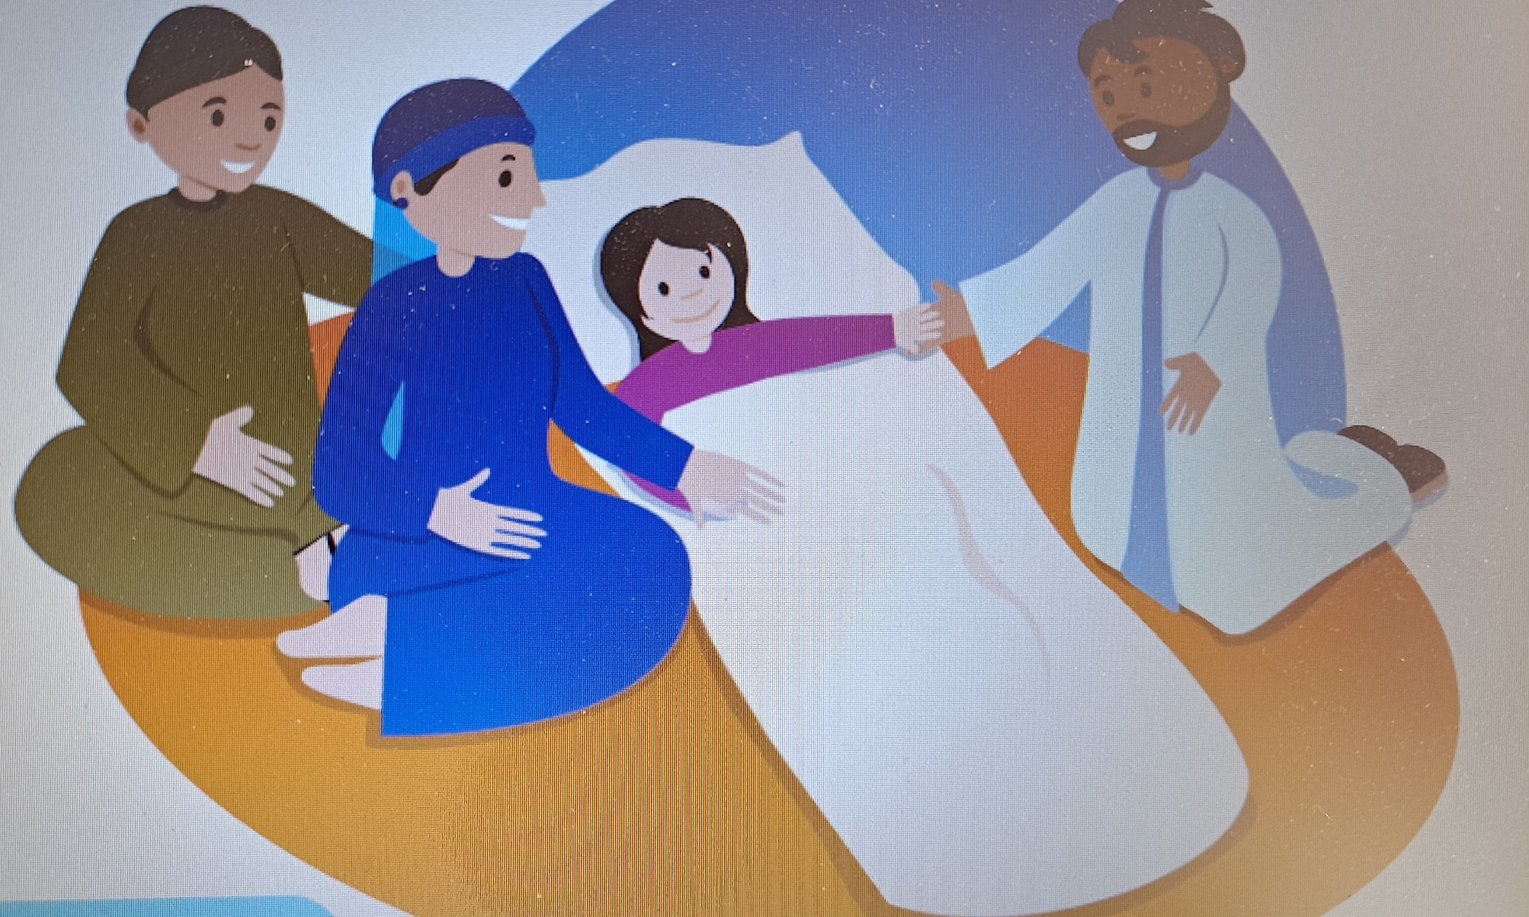
Jesus raises the daughter of Jairus

Slide 5
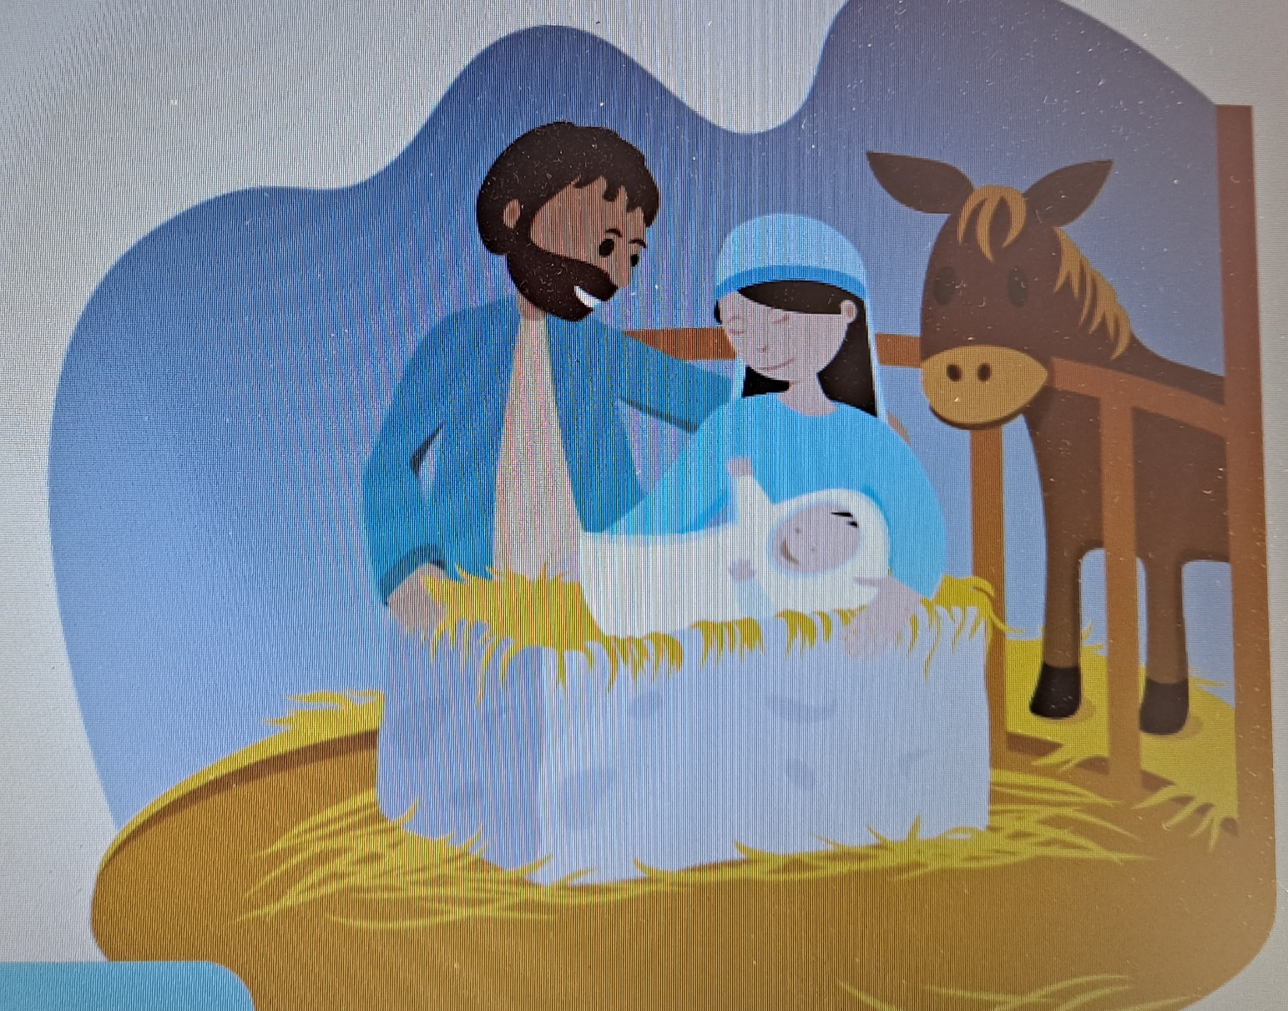
The Birth of Jesus

Slide 6
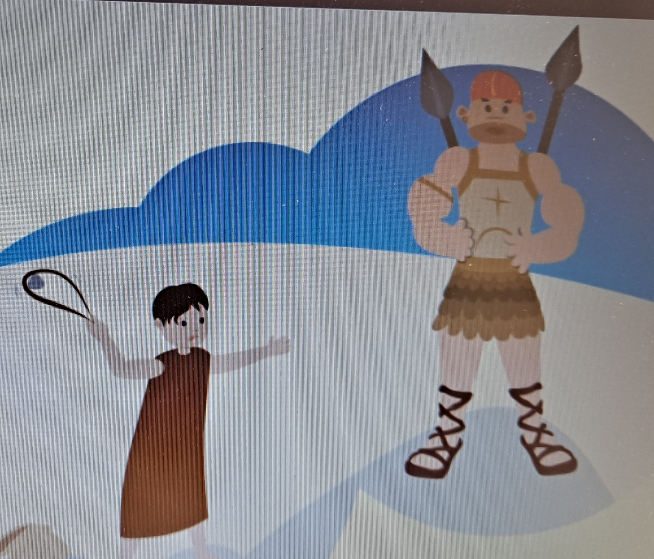
David and Goliath

Slide 7
Jesus Forgives Our Sins in the
Sacrament of Reconciliation

Slide 8
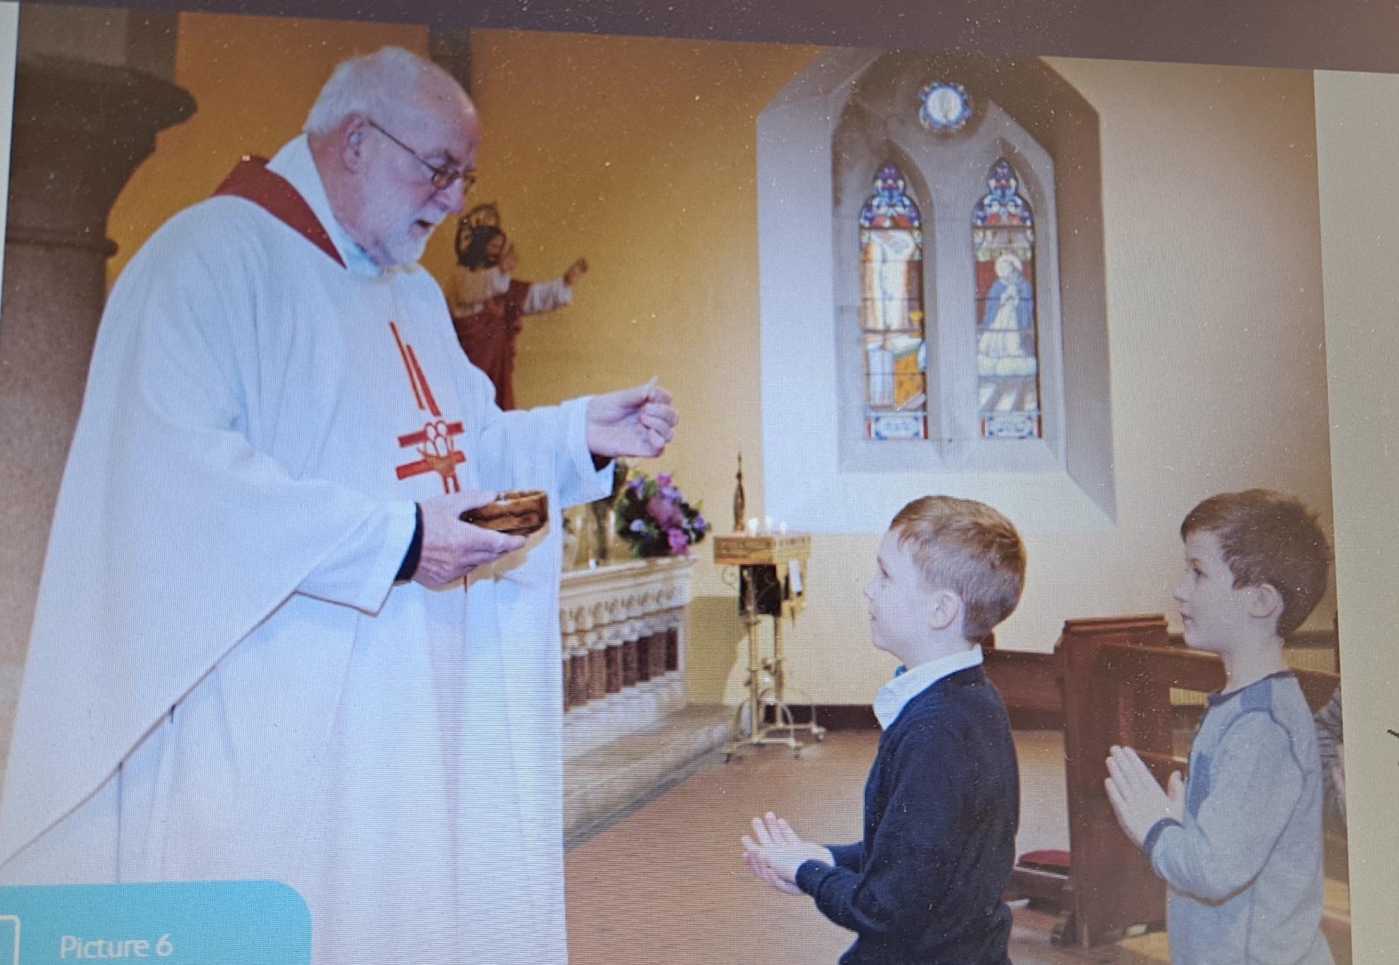
We receive the Body of Jesus in Holy Communion

Slide 9
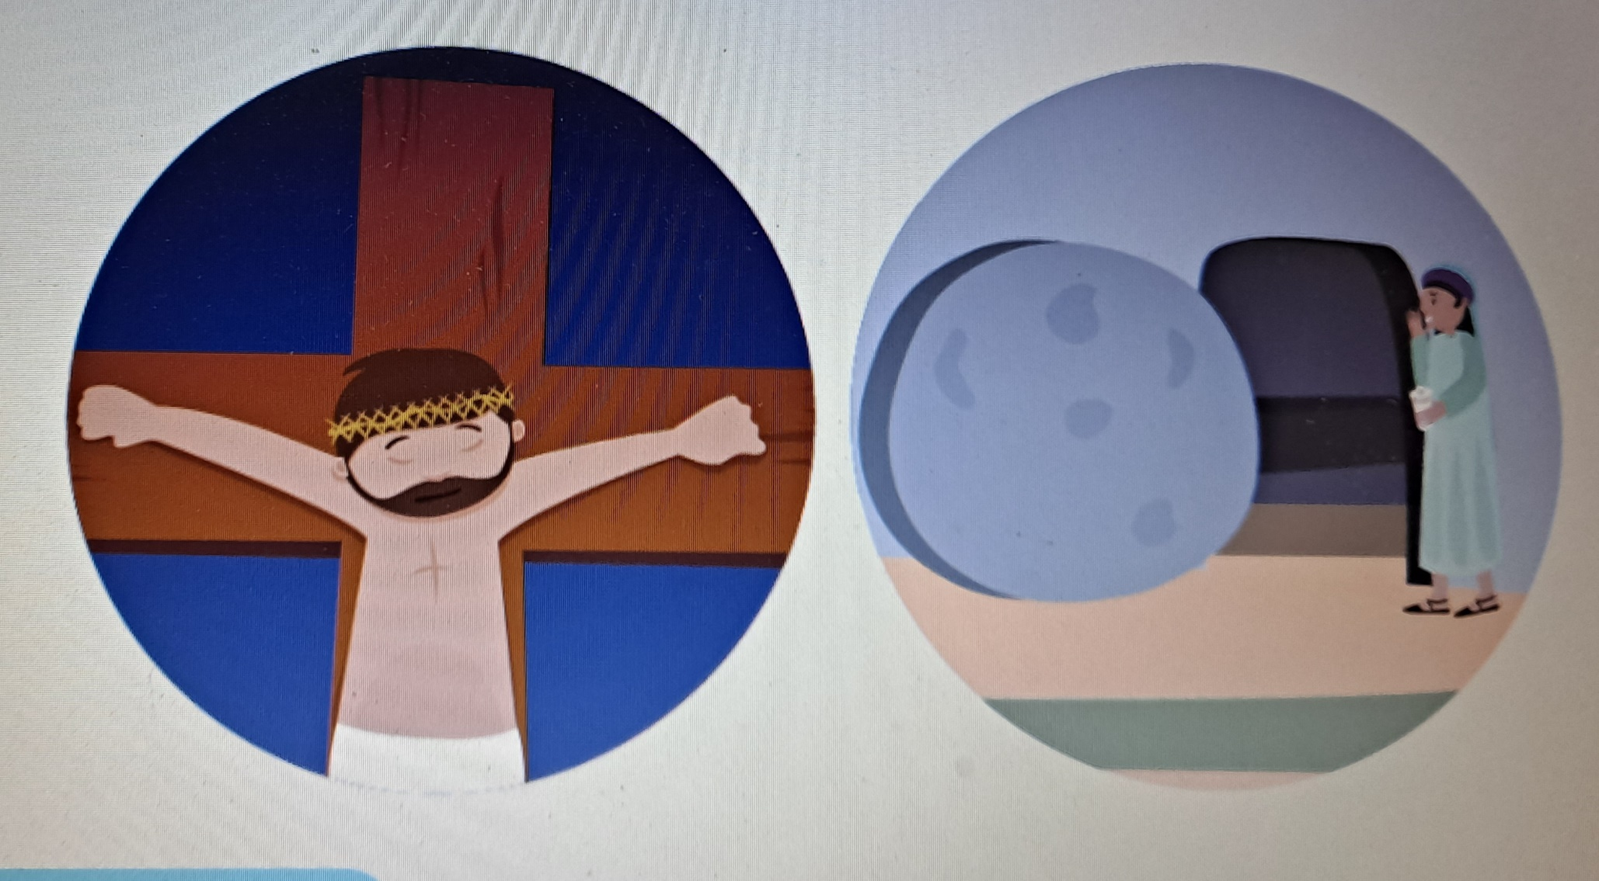
Jesus died on Good Friday and
Rose from the Dead on Easter Sunday

Slide 10
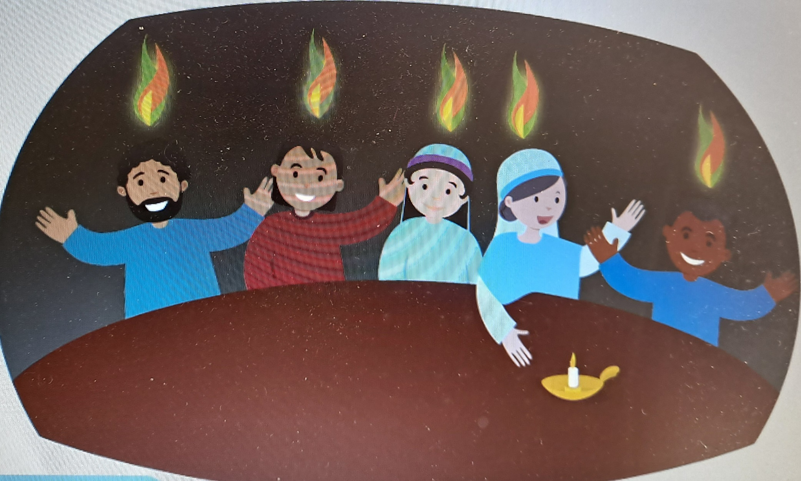
The Holy Spirit Came on the Disciples at Pentecost

Slide 11
Chatting
What were your favourite stories this year?
What were your favourite songs?
What is your favourite prayer?
What do you remember most about Grow in Love this year?

Slide 12
Let’s Live…..
Mark the end of the school year with a special prayer service.
Choose prayers, hymns and a reading that is your favourite from the year.
This year has been a very different year for you.
God has been with you through every minute.
If celebrating the prayer service in your home, take time to plan it and to set up a sacred space to reflect what was good about this year for you, what you wish to give thanks to God and what you wish to ask of God.

