Slide 1
Grow in Love 4
Theme 9: Creation
Lesson 1: God Created Us

Slide 2
Let’s Look…..
Go to the Grow in Love website and click on the interactive Treasure Trail to answer some questions about creation.
Go to www.growinlove.ie Username: trial@growinlove.ie Password: growinlove
https://app.growinlove.ie/interactives/2nd_treasuretrail/index.php#
Discussion
What did you notice about all the things that you found along the way of the Treasure Trail?
What other things did God make, that you did not find on the Treasure Trail?
I wonder….why did God decide to create all of these things?

Slide 3
Let’s Learn……
Scripture
God Created People
Click on audio button

Slide 4
Discussion
What was the last thing that God created?
God made people good and loving: Why do you think God wanted people to be good and loving?
Why did God make us all different?
What would it be like if we were all the same?
God wanted people to look after one another.
Can you think of a time when you cared for someone else?

Slide 5
God created us all different.
No two people are exactly the same. Even identical twins have differences.
We each have a special set of gifts and talents.
God has given us our gifts and talents as he wants us to be happy and to enjoy life.
Think and discuss what differences you might find in people in your class and in your family.
What do you have in common with one another?
Look at the pictures on the next few slides.

Slide 6
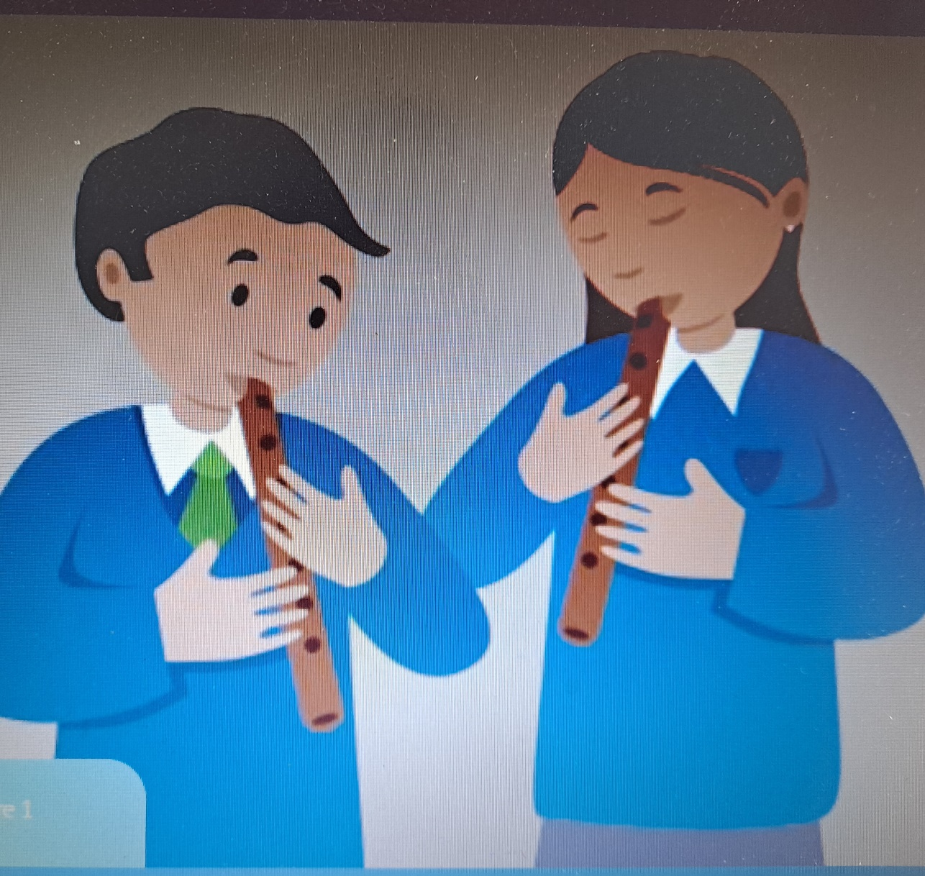
What are the people in the picture doing?
Can you, or anyone you know play a musical instrument?
What do you like to sing or play?

Slide 7
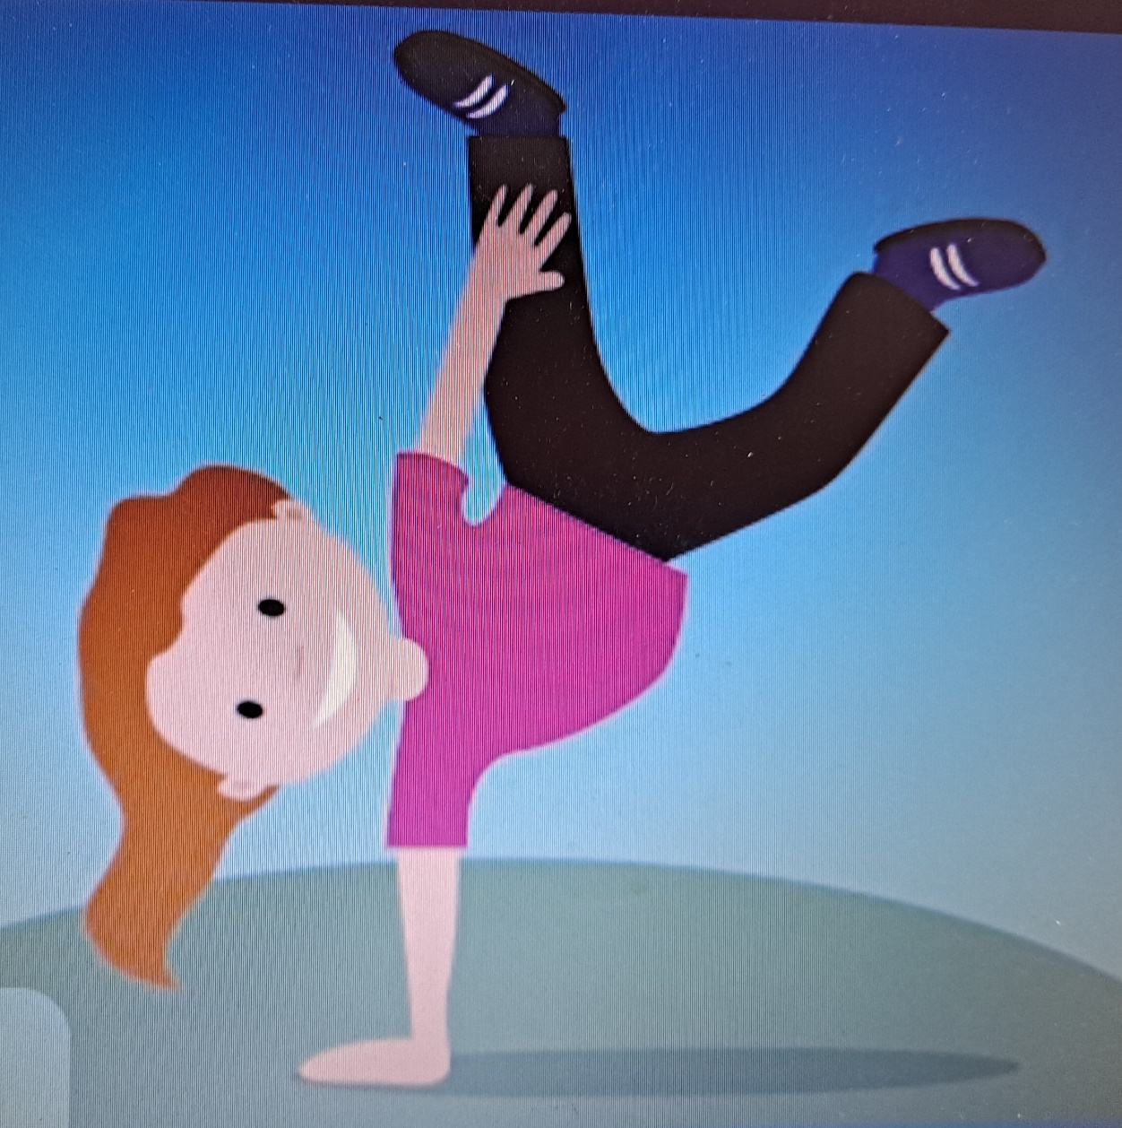
God gave us the gift of our bodies.
Some people are good at doing great things with their bodies.
What is the girl doing in the picture?
Do you like to run, skip, hop, jump or dance?

Slide 8
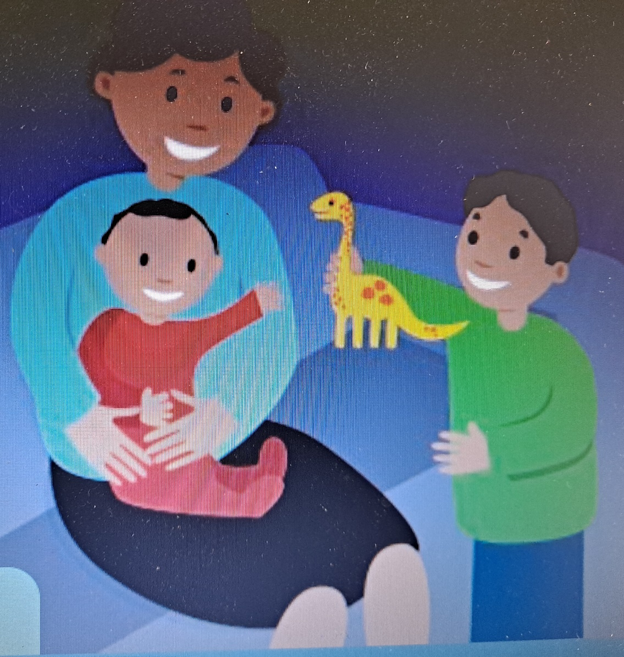
What are the people in this picture good at, do you think?
Do you like to care, share, talk to and help other people?

Slide 9
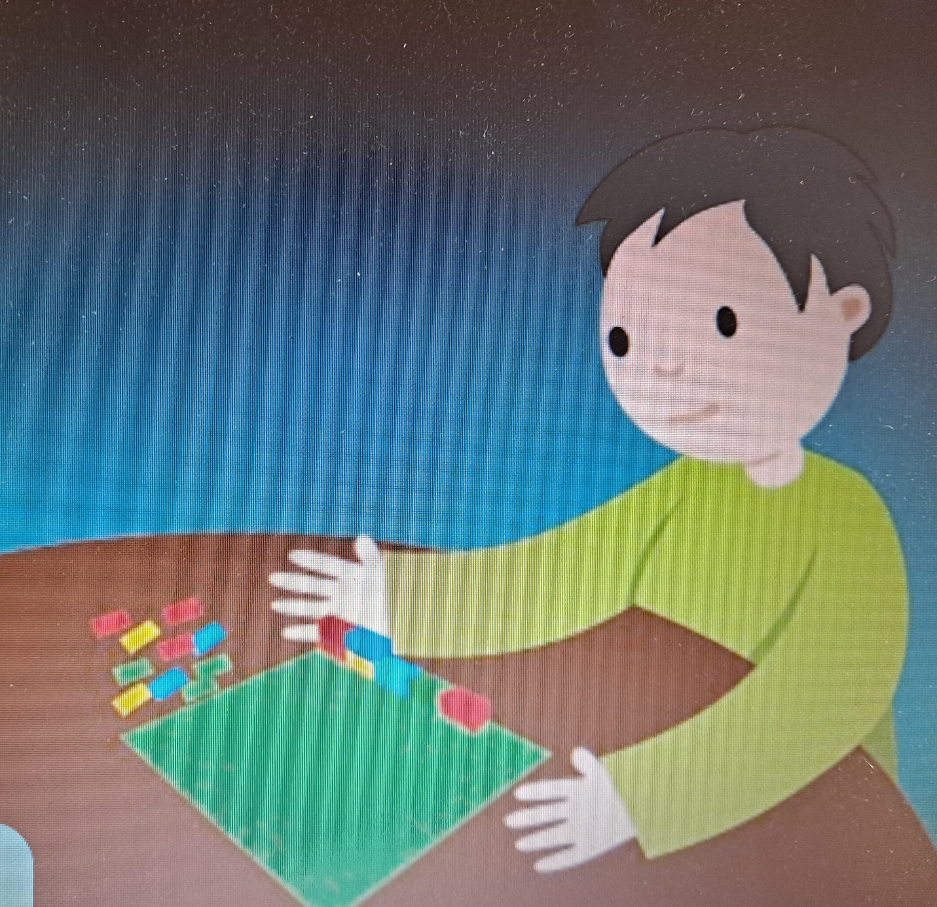
The person in this picture likes to be on their own sometimes.
Do you like to be on your own?
What do you like to do on your own?

Slide 10
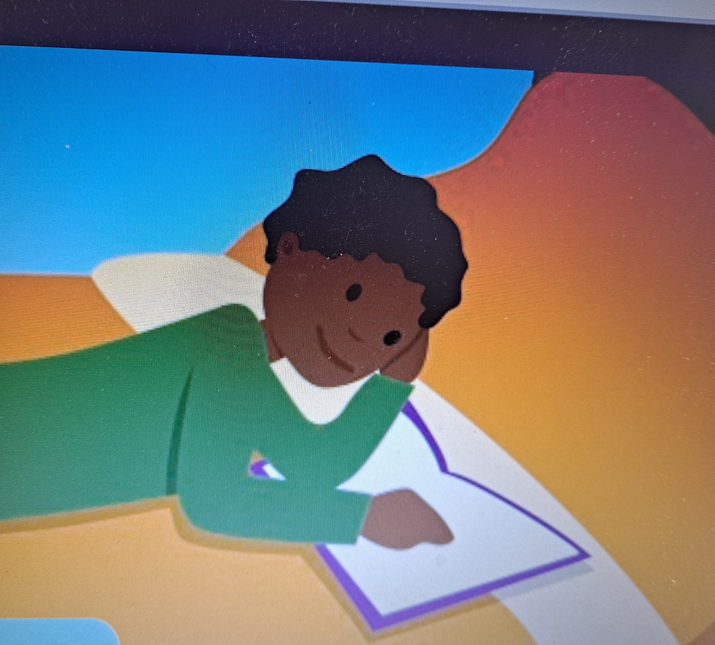
What gifts has this person, do you think?
Do you like to read and write stories?

Slide 11
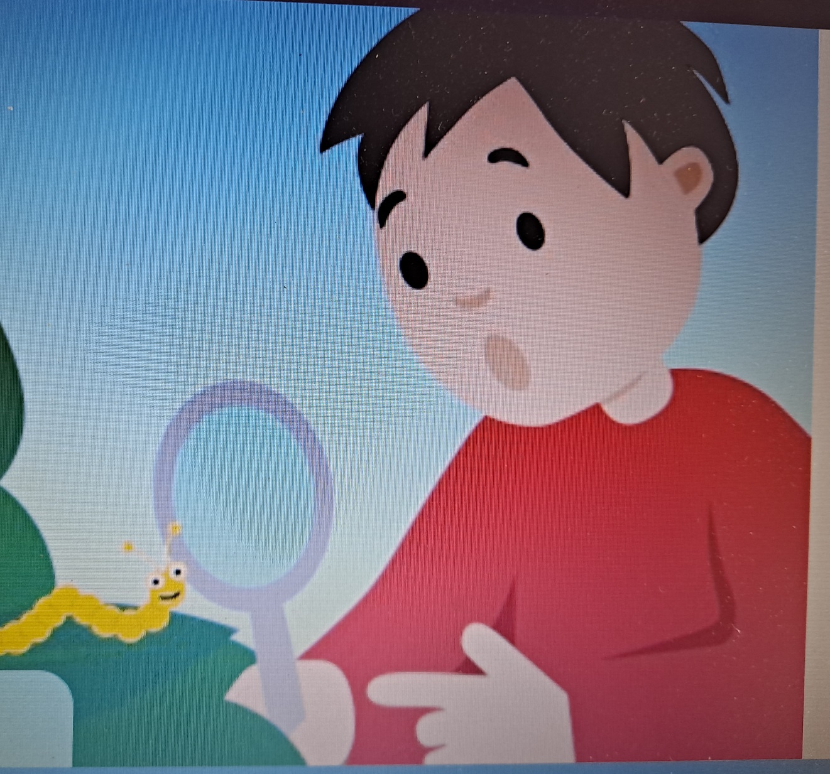
What is this boy doing?
Do you like to be outdoors investigating?
D you like looking at the trees, birds, animals, insects?

Slide 12
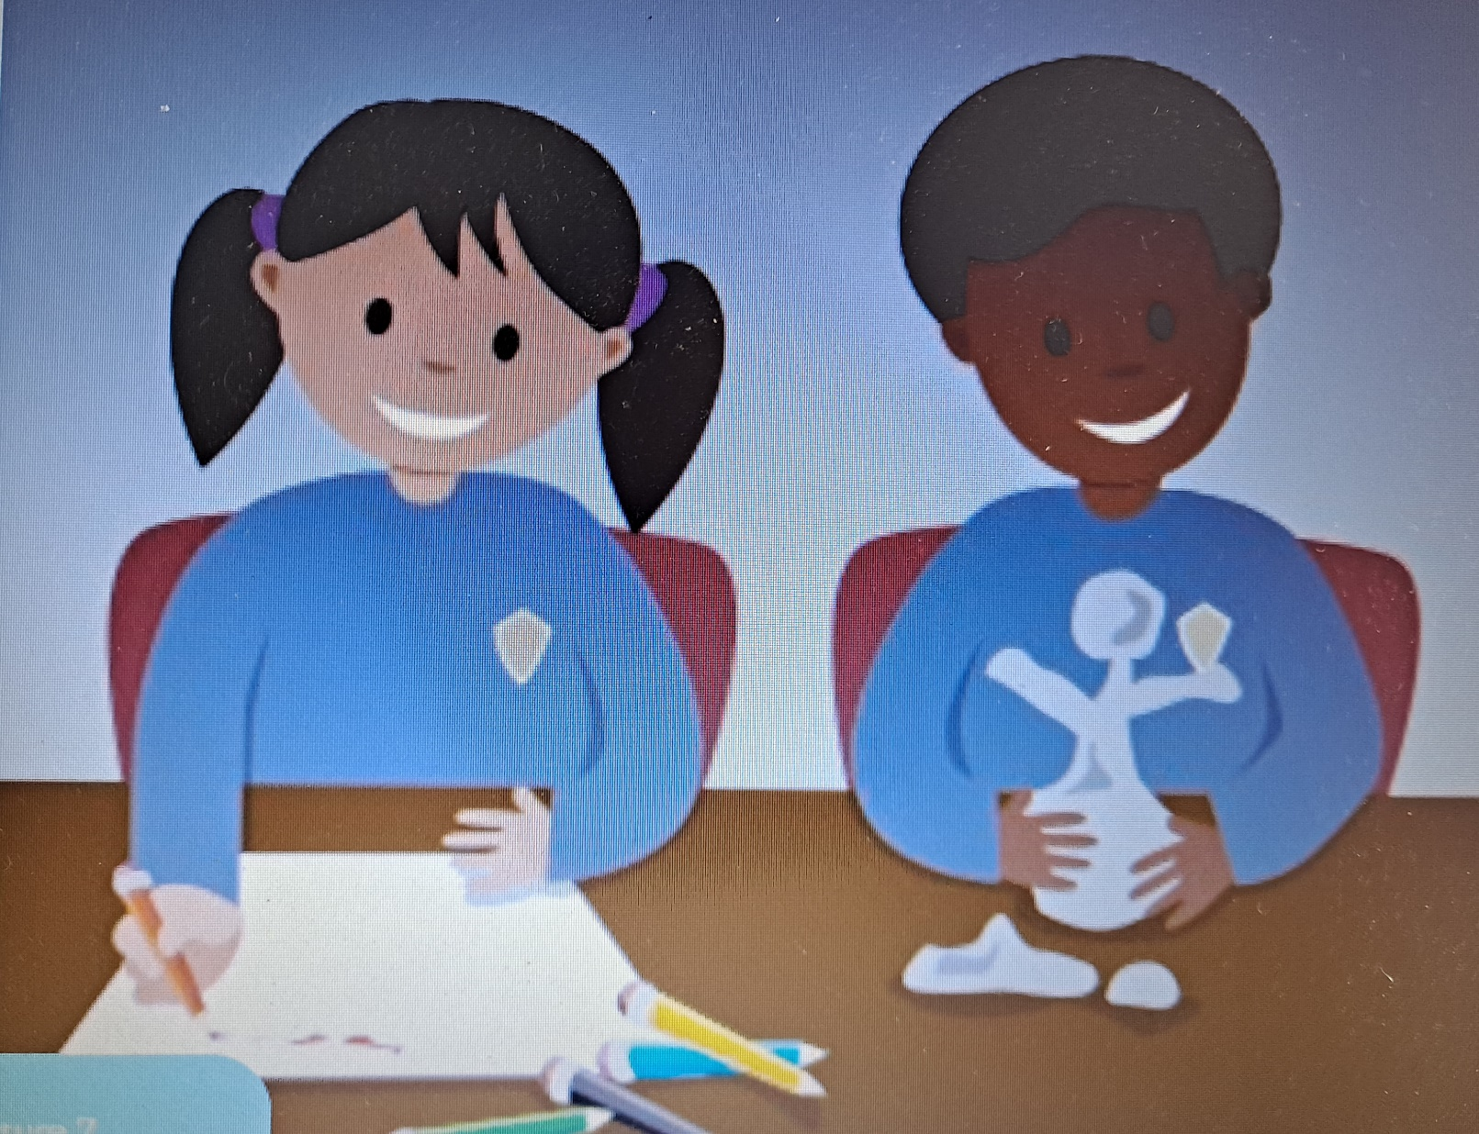
What do you notice about the people in this picture?
What are they doing?
Are you good at drawing?

Slide 13
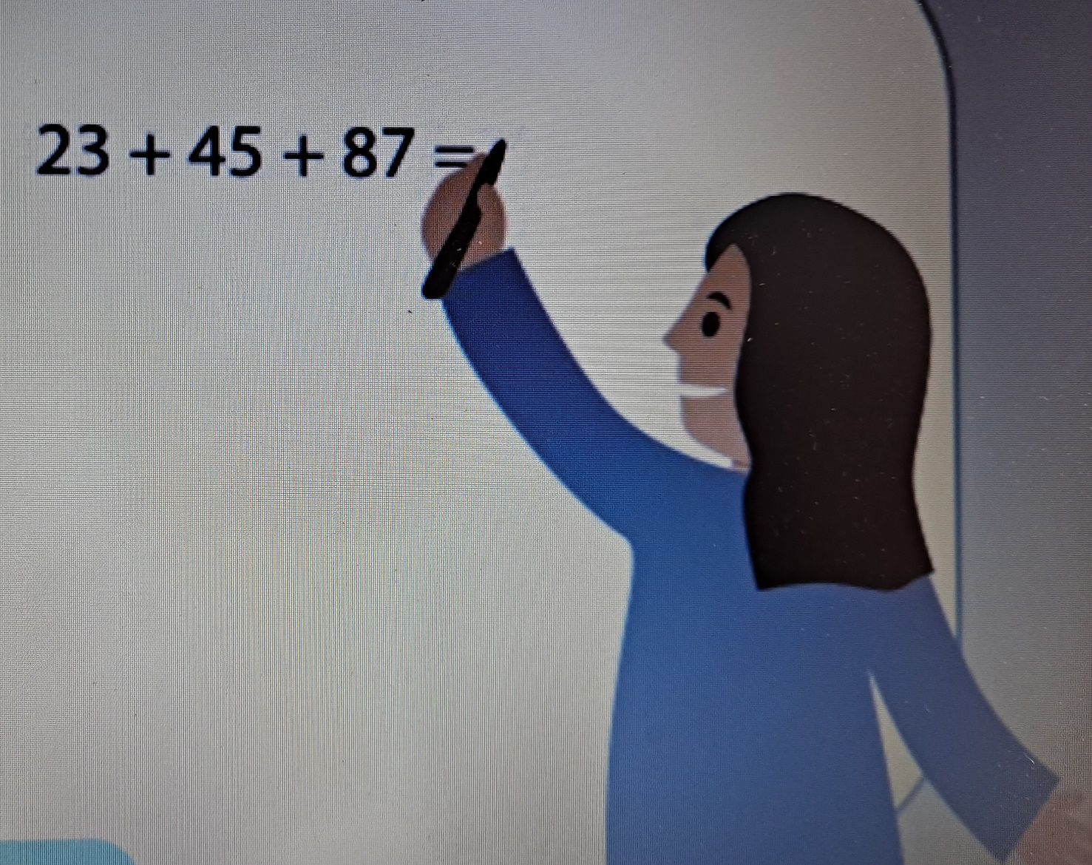
What is the person in the picture doing?
What is that person good at, do you think?
Do you like Maths and numbers?

Slide 14
Pupil’s Textbook: Page 50
Fill in the blanks and discuss.
Page 51: Fill in the boxes.

Slide 15
Let’s Live…..
Activity: Our Gifts Paper Chain
Write one of your gifts on a piece of paper.
Everyone in your class or family will do the same.
Link all the strips together to make a paper chain.
All our gifts and talents are linked together.

Slide 16
Prayer
The hymn Quiet and Still forms part of the prayer time, so please have it ready to play from the lesson on the Grow in Love website.
Glory be to the Father
And to the Son
and to the Holy Spirit
As it was in the beginning.
Is now and ever shall be.
World without end.
Amen
Click on audio button

